Slide 1
BIT 353 ARTIFICIAL INTELLIGENCE
Lecturer: Saroj Poudel
Qualification: MS CIS&IT
Profession: Senior Software Developer/CTO
Lincoln University College, CN 1221

Slide 2


Uninformed Search Strategies
An uninformed search algorithm is given no clue about how close a state is to the goal(s).
Also known as Blind search.
For example, consider our agent in Arad with the goal of reaching Bucharest.
An uninformed agent with no knowledge of Romanian geography has no clue whether going to Zerind or Sibiu is a better first step.

Slide 3
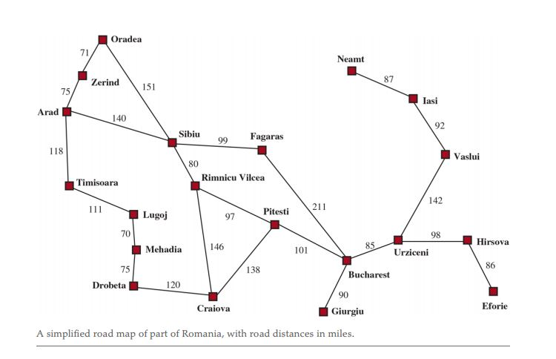

Slide 4
Breadth-First Search
When all actions have the same cost, an appropriate strategy is breadth-first search.
BFS is a search strategy for traversing a tree or a graph.
In which the root node is expanded first, then all the successors of the root node are expanded next, then their successors, and so on.
Queue(FIFO) is used for searching.
The time complexity is O(b^{d}) where b is branching factor and d is the depth.

Slide 5
Advantages and disadvantages
Advantages:
BFS guarantes to provide a solution if solution exist.
If there are more than one solution to a problem then BFS will provide the optimal solution.
Disadvantages:
It requires a lot of memory to process.
It needs more time to process.

Slide 6
Depth First Search
DFS is an algorithm for traversing tree or graph data structure.
DFS traverses in a depth ward motion.
DFS search start from the root node of the tree and traverse all the branches of the node with backtracking method.
Backtracking means when you are moving forward and there are no more nodes along the current path, you move backwards on the same path to find nodes to traverse.
Stack (LIFO) data structure is used for searching.

Slide 7
Advantages vs Disadvantages
Advantages
Memory requirement is linear on the base of Nodes.
DFS uses less time and space complexity than BFS.
Disadvantages
DFS will not guarantee to find the solution.
If two solution exists, then it may not provide the optimal solution.

Slide 8
Uniform Cost Search
Uniform cost search can be used if the cost of travelling from one node to another is available.
Uniform cost search always expands the lowest cost node.
The first solution is guaranteed to be the cheapest one.
Priority queue is used for searching.
Also called Dijkstra’s Algorithm.

Slide 9
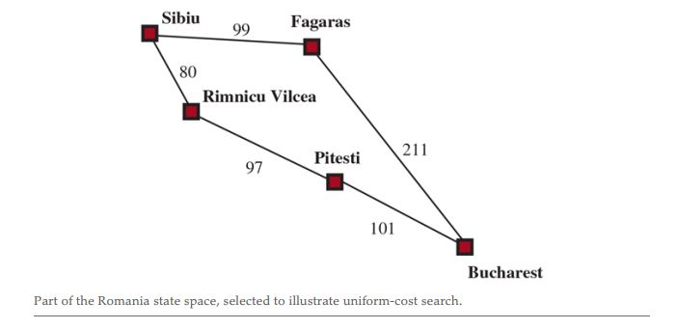
The successors of Sibiu are Rimnicu Vilcea and Fagaras, with costs 80 and 99, respectively.
The least-cost node, Rimnicu Vilcea, is expanded next, adding Pitesti with cost 80+97 = 177.
The least cost node is now Fagaras, so it is expanded, adding Bucharest with cost 99+211 =310.
Bucharest is the goal, but the algorithm tests for goals only when it expands a node, not when it generates a node.
The algorithm continues on, choosing Pitesti for expansion next and adding a second path to Bucharest with cost 80 + 97 + 101 =278. It has a lower cost, so it replaces the previous path in reached and is added to the frontier(priority queue).

Slide 10
Advantages vs Disadvantages
Advantage
Uniform-cost search is complete and is cost-optimal, because the first solution it finds will have a cost that is at least as low as the cost of any other node.
Disadvantages
The storage required is exponentially large.
The algorithm may be stuck in an infinite loop as it considers every possible path going from the root node to the destination node.

Slide 11
Informed Search
Uses domain specific hints about the location of goals
Can find solutions more efficiently than an uninformed strategy
The hints come in form of a heuristic function, denoted by h(n).
For example, in route-finding problems, we can estimate the distance from the current state to a goal by computing the straight-line distance on the map between the two points.

Slide 12
Greedy best first Search
Greedy best-first search is a form of best-first search that expands first the node with the lowest value—the node that appears to be closest to the goal—on the grounds that this is likely to lead to a solution quickly.
So, the evaluation function is f(n) = h(n).

Slide 13
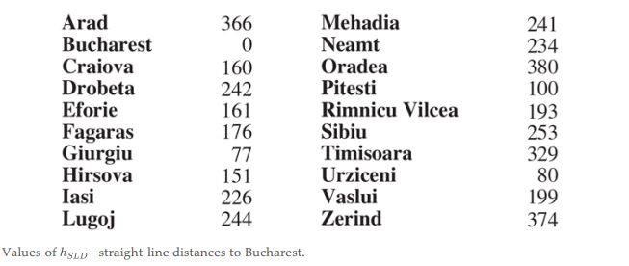
Using straight line heuristic
Note: It takes a certain amount of world knowledge to know that is correlated with actual road distances and is, therefore, a useful heuristic.

Slide 14
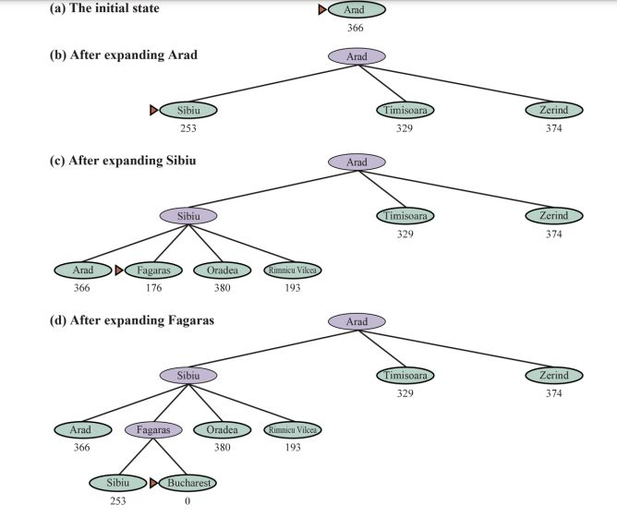

Slide 15
A* Search
It is the most common informed search algorithm.
It is a best-first search that uses the evaluation function
f(n) = g(n) + h(n)
Where g(n) is the path cost from the initial state to node n, and h(n) is the estimated cost of the shortest path from to a goal state, so we have
f(n) = estimated cost of the best path that continues from n to a goal.

Slide 16
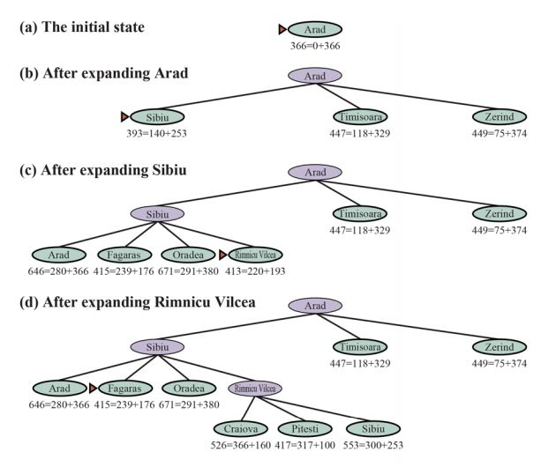

Slide 17
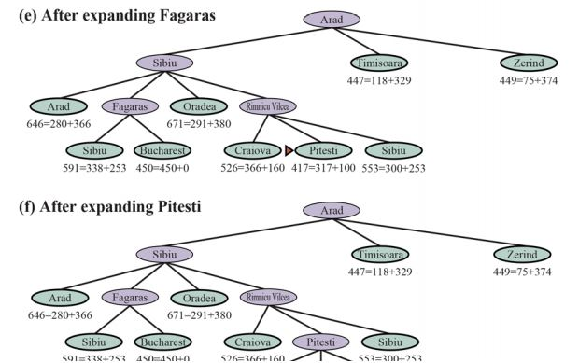
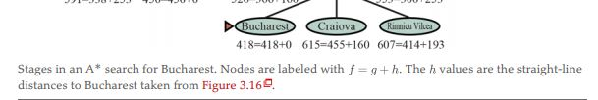

Slide 18
A * search
Whether A* is cost-optimal depends on certain properties of the heuristic.
A key property is admissibility: an admissible heuristic is one that never overestimates the cost to reach a goal. (An admissible heuristic is therefore optimistic.)

